Slide 1

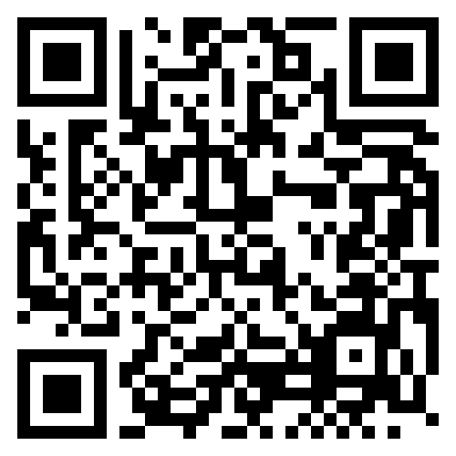
Recursion
Demo Lesson 1/21/2025s
Dr. Michael Robbeloth

Slide 2

Who Am I?
Dayton, Ohio native
Lived in Amish country past six years, Knox County, has 64k inhabitants
Worked approximately 18 years in industry/consulting (primarily embedded and distributed computing)
Almost eight years in academia
Ph.D. from Wright State (all Ohio colleges/Universities)
Married 22 years
Generation X dad with Generation Alpha daughter (6 years old)
No millennial or Gen Z kids ☺
Dachshund daddy, nine-year-old black & tan Leonie
I love Computer Science and being a geek!
Hobbies: Photography, Hiking, Slow Running, Travel, & Gaming (Just One More Turn!)
Twitter LinkedIn, & Instagram @mrobbeloth

Slide 3
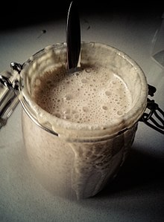
Learning Outcomes
Define recursion
Describe the principles of recursion
Analyze and evaluate recursive algorithms
Write one ourselves
If we have time:
Determine the output of code segments w/ recursion

Slide 4
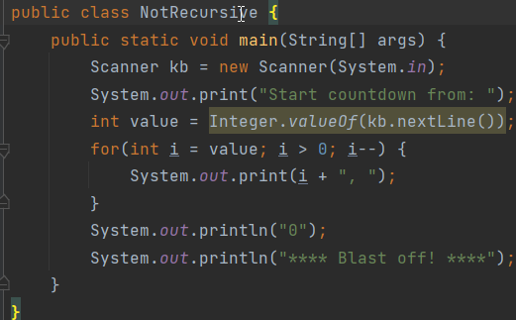
What are the three basic programming statements?
Sequential (Ex. assignment, normal procedural/method invocation)
Conditional (Make a Decision)
Iterative (Repeat sequence of instructions)

Slide 5
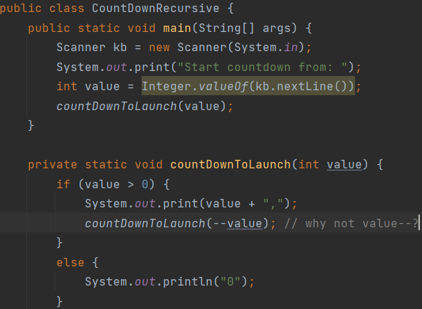
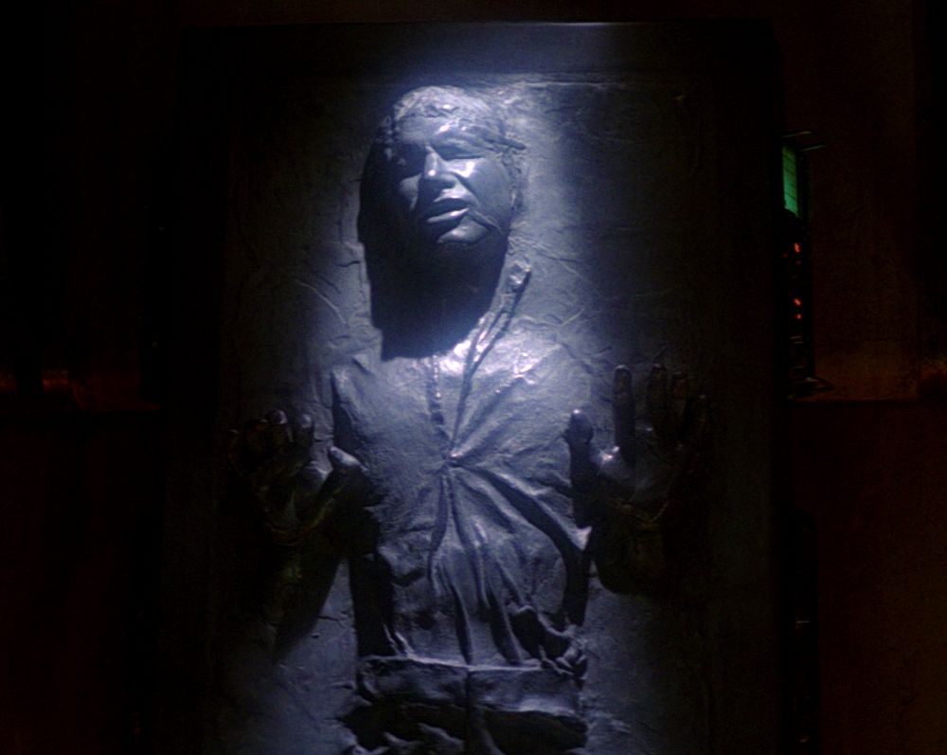
Now let’s consider a fourth type of programming statement
Can anyone define recursion for me?
What if we could have a statement that calls the procedure it is already running inside of?
That would be awesome.
Indeed, we do, it’s call recursion

Slide 6

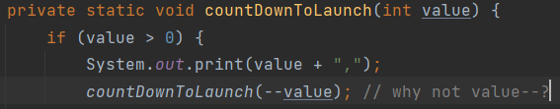
I have a question? (You should have a question at this point)
It won’t take that long ☺
Exception in thread "main" java.lang.StackOverflowError
Don’t loops have a way to stop themselves?
Yes! (some terminating exp./stmt.)
So, what happens when there isn’t some mechanism to stop the loop?
We need to make the problem smaller when we call the procedure again
Did you recall how we made the count down method simpler on each call?

Slide 7
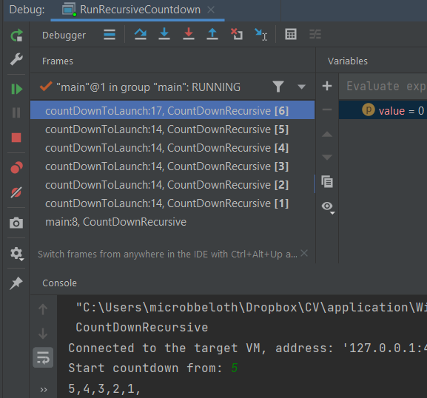
A deeper inspection on recursion

Slide 8
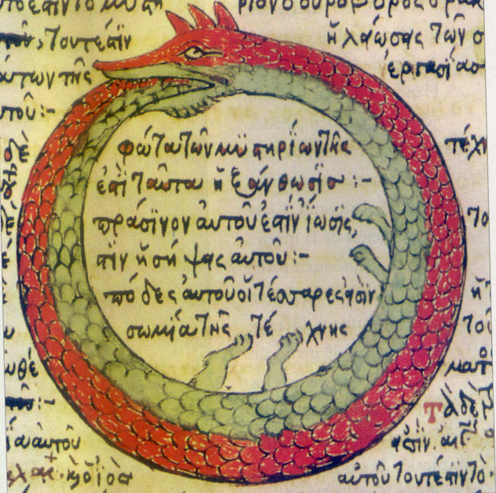
To recap…
Recursion is a computational problem-solving method whereby we have a procedure (e.g., function) that calls itself
Each time, we have a recursive, problem-reducing, step
Eventually, we reach one or more base cases (w/no recursion)
The power of recursion evidently lies in the possibility of defining an infinite set of objects by a finite statement. In the same manner, an infinite number of computations can be described by a finite recursive program, even if this program contains no explicit repetitions. Niklaus Wirth

Slide 9
What’s the tradeoff between recursion and iteration?
Have equal expressive power
Recursion makes some problems easier to solve
Iteration makes other problems easier to solve
Recursion incurs a performance penalty w/o tail call optimization (not sure about recent versions of Java/JEPs, but not available, would need Scala/Groovy/Clojure)
Recursion needs more storage needed

Slide 10
Display Numbers As Words
Number has multiple digits
Need to write out the word for each digit
What are our subtasks here?
Display all digits but the last as words
Display last digit as a word
Which one is the base case vs reduction step?

Slide 11
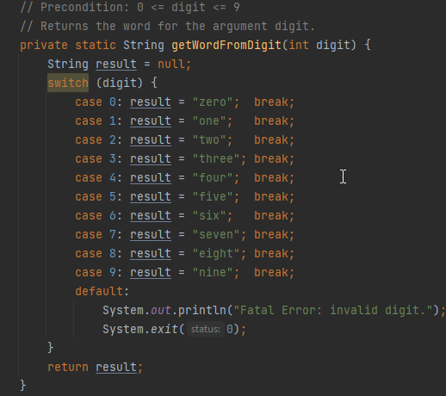
Display Numbers As Words Base Case

Slide 12
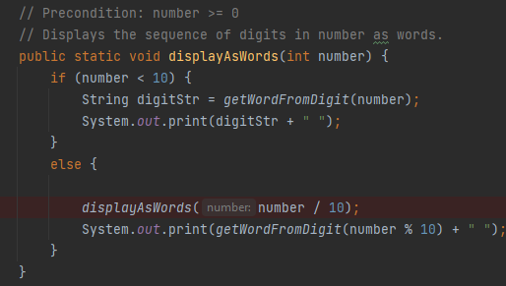
Display Numbers As Words Reduction Step

Slide 13
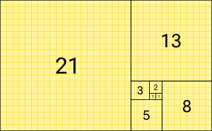
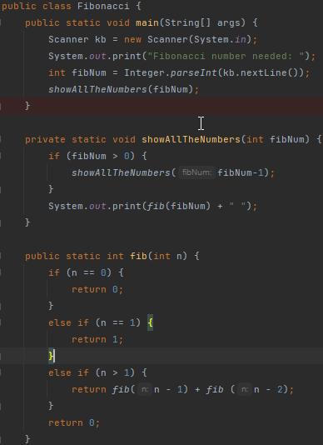
Fibonacci
Each number is the sum of the preceding two numbers
F₀ = 0
F₁ = 1
For K > 1 F_{K} = F_{K-1} + F_{K-2}
What is/are our base case(s)?
How do we use recursion to make the problem smaller? What is the reduction step?

Slide 14
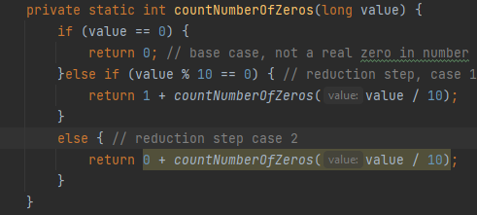
Let’s do this together -- Find number of Zeros
Count the number of zeros in the number?
What is the base case vs reduction step?

Slide 15


Sierpinski Triangle
Equilateral triangles subdivided recursively into equilateral triangles
Reproducible at any level of detail w/enough computational power
Start w/ equilateral triangle
Subdivide into four smaller congruent triangles using an upside-down equilateral triangle
“Remove” the central triangle
Repeat w/ smaller triangles inside
x/4 area removed first cut
(3 * 1)x/(4*4) second cut; (3 * 3)x/(16*4) third cut or 3x/16 and 9x/64
Using infinite geometric sequence add all terms
Given 1st geometric term and common ratio:
a₁ / (1 – r) = x/4 / (1 – ¾)=1 ; in general: a_{n}=1/2(3^{n}-1)

Slide 16
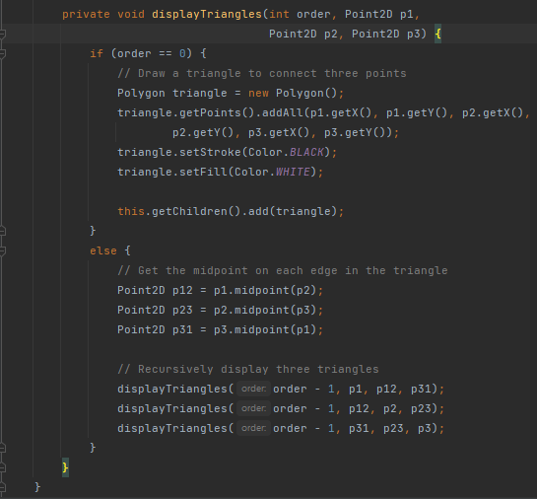
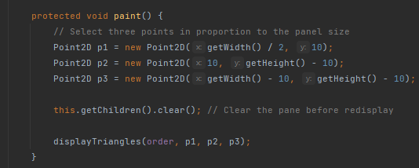
Sierpenski Triangle Code Sample

Slide 17
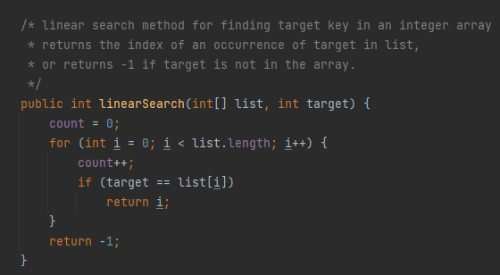
Searching
If an array is sorted, what’s a simple way to search it?
Start at the beginning and look at each element.
If not sorted, must do it this way

Slide 18
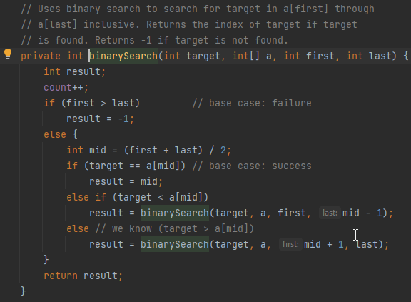
Deeper Dive Binary Search
Binary Search
Find out if a number is in a sorted array
Do it recursively, of course.
Where do we start?
Middle of the array
What do we keep track of?
Target, array, first, and last index.
What if the number isn’t there? When would this occur?
First > Last Return some negative value
What if the target is less than midpoint?
Call procedure again w/ first and last = mid – 1
What if target is greater than midpoint
Call procedure again w/ first = mid + 1 and last

Slide 19
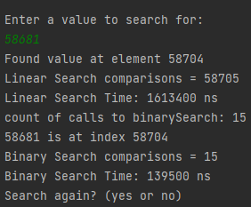
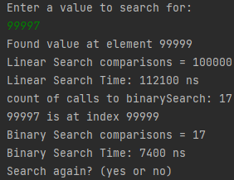
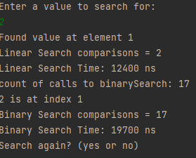
Binary Search Performance
Extremely Fast
~½ array eliminated at each call to method
1000 elements, ~10 array searches worse and average case
100,000 elements, ~17 array searches
Vs sequential w/ 1000 elements needing ~500 comparisons on average
In general, for n elements:
log₂(n) worse case
log₂(n) average case
1 comparison best case

Slide 20

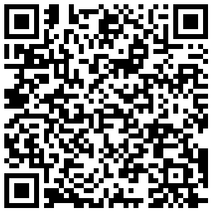
Questions
Thank You!
Presentation at QR below:

Slide 21
Overtime
2. What output will be produced by the following code?
public class Demo {
public static void main(String[] args) {
System.out.println("The output is:");
bar(11156);
System.out.println();
}
public static void bar(int number) {
if (number > 0) {
int d = number % 10;
boolean odd = (number / 10) % 2 == 1;
bar(number / 10);
if (odd)
System.out.print(d / 2 + 5);
else
System.out.print(d / 2);
}
}
}
1. What output will be produced by the following code?
public class Demo {
public static void main(String[] args) {
System.out.println("The output is:");
foo(23);
System.out.println();
}
public static void foo(int number) {
if (number > 0) {
foo(number / 2);
System.out.print(number % 2);
}
}
}

